Slide 1
TECHNICIAN NETWORKS LTD
CORPORATE SOCIAL RESPONSIBILITY REPORT
2025

Slide 2
MESSAGE FROM OUR
EXECUTIVE LEADERSHIP TEAM
Technician Networks Ltd
As the executive leadership team of Technician Networks Limited, we understand that our success as a leader in telecommunications construction goes hand-in-hand with our responsibility to make a meaningful and positive impact on society. We believe that sustainable and ethical business practices are the foundation of long-term growth—not just for our company, but for the communities we serve, the environment we operate within, and the people whose lives we touch.
This Corporate Social Responsibility (CSR) report outlines the key initiatives we have pursued in our ongoing commitment to driving positive change. Our approach to CSR is built on the principles of integrity, transparency, and accountability. From advancing our environmental sustainability efforts to creating local jobs and improving community infrastructure, we are dedicated to ensuring our business practices create value in every sense.
As we continue to expand our operations and build the future of telecommunications, we remain focused on our duty to society. We are committed to reducing our environmental impact, fostering diversity and inclusion, and contributing to the prosperity of the communities in which we live and work.
While we are proud of what we’ve achieved thus far, we are not complacent. Our leadership team is dedicated to continually evolving our CSR strategies to address the challenges of an ever-changing world, ensuring that our legacy is one of progress, responsibility, and shared success for all stakeholders.
Together, we will continue to build not just infrastructure, but a future where our business contributes to lasting, positive change in every community we touch.

Slide 3
Technician Networks Ltd
Our objectives for 2025, however small, provide a clear roadmap for a CSR initiative focused on street lighting, ensuring measurable impact on safety, sustainability, and community well-being. These were governed by leaving below impact in communities where we operate
1. Enhance Public Safety
Objective: To improve public safety by providing well-lit streets in locations prone to criminal activity.
Goal: To lower crime rates by 20% within the first year of implementing street lighting improvements
.
2. Improve Community Well-being
Objective: To create a safer and more welcoming environment for pedestrians, cyclists, and drivers through the installation of energy-efficient street lighting.
Goal: To increase community engagement and satisfaction with public spaces by 30%, as measured through surveys or community feedback.
3. Foster Community Engagement and Participation
Objective: To engage local residents and stakeholders in the planning and implementation of street lighting projects to ensure the solutions meet their needs.
Goal: To involve at least 25% of the local population in community consultations or feedback sessions.
4. Support Long-Term Maintenance and Sustainability
Objective: To ensure the long-term viability and maintenance of the street lighting system through regular monitoring and a sustainable maintenance plan.
Goal: To create a sustainable maintenance model that reduces operational costs and ensures system longevity, with a goal of maintaining at least 95% operational efficiency over five years.
OBJECTIVES

Slide 4
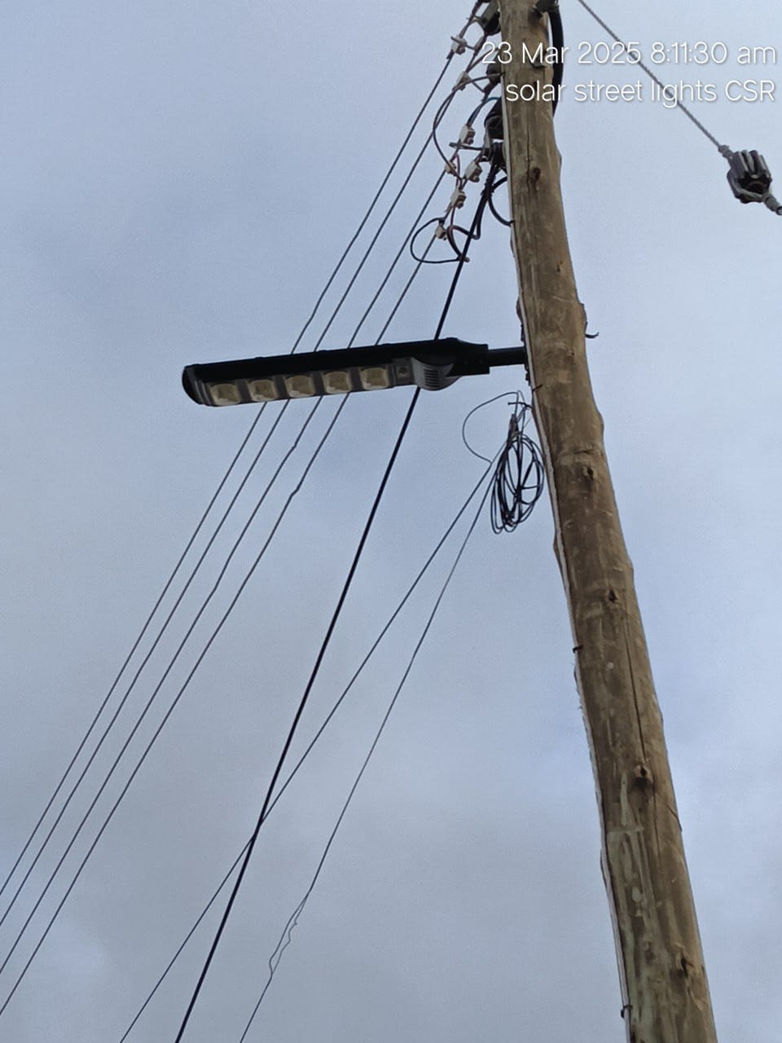
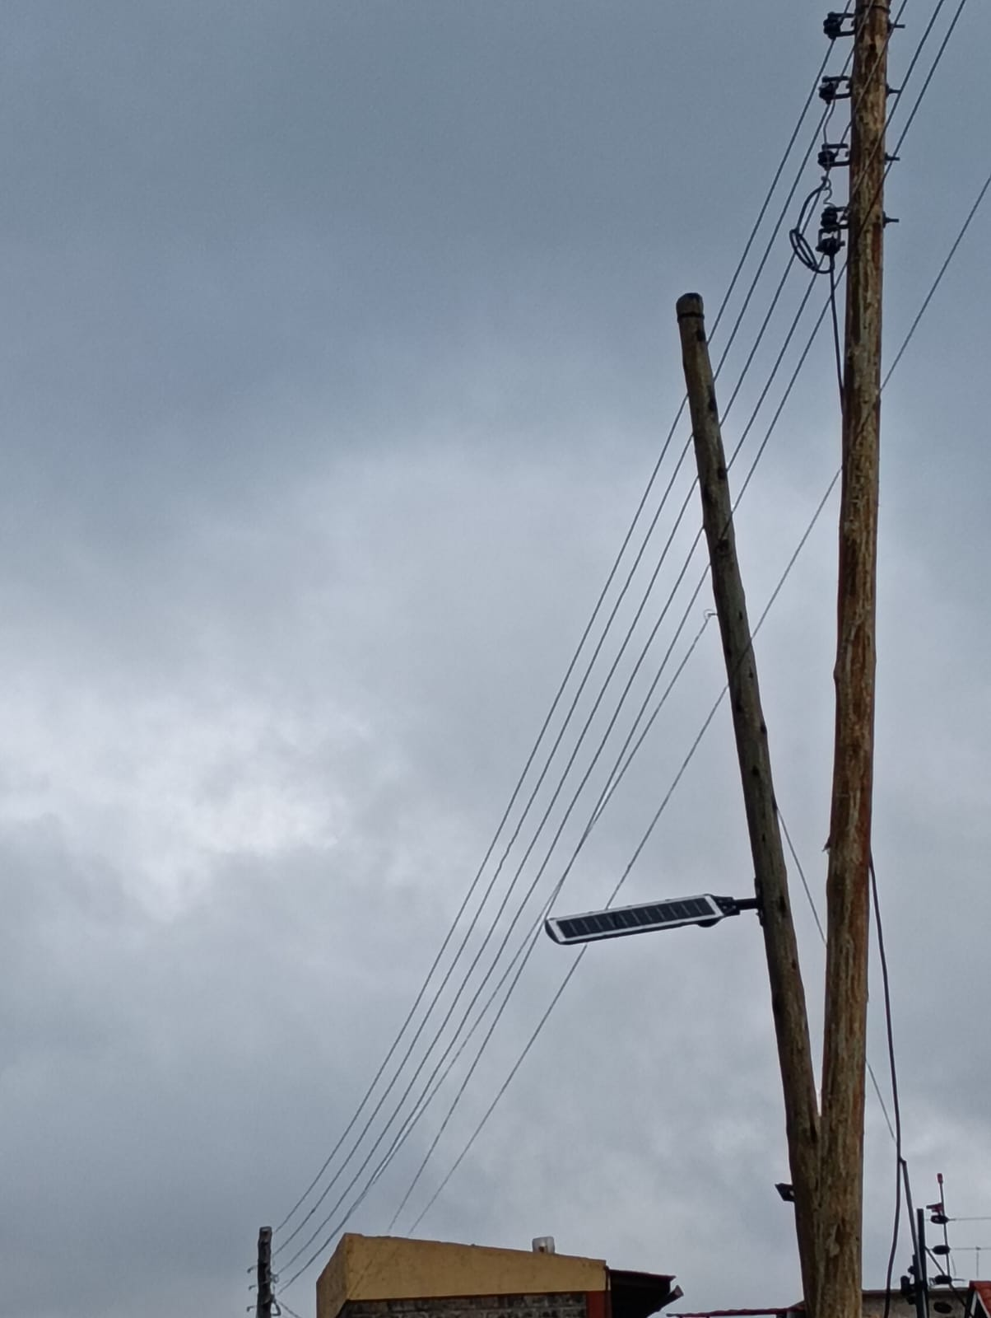
Lighting the way to safer, eco-friendly streets with energy-efficient LEDs in Juja as a response to insecurity during our project deployment
Technician Networks Ltd

